Slide 1

Steering Committee Meeting
August 17, 2016

Slide 2
Steering Committee Members
Association | Member | Present? Y/N/Rep
FPI | Bevin Morrissey Aaron Clayton Rebecca McFarland Bob Hoffman Charles Branche Scott Rackliffe Dan Welch Jeff Marshall Jason Hilzendeger LeeAnne Nikolao
AgCountry | Kari Seidel
Farm Credit East | Steve Rickenbacher Ryan Hrobuchak
Farm Credit West | Melissa Gomes
Northwest | Jacob Ruland
Yankee | Kyle Lussier

Slide 3
Agenda
Greetings and Intro
Defined Items
Undefined Items

Slide 4
Defined Items
FEMA Hyperlink for flood maps on Buildings Panel
2017 IRS Requirements for Real Estate Collateral
Fix the Lien Position / Loan Position
Calc Change for Participation Loans Secured by Chattel

Slide 5
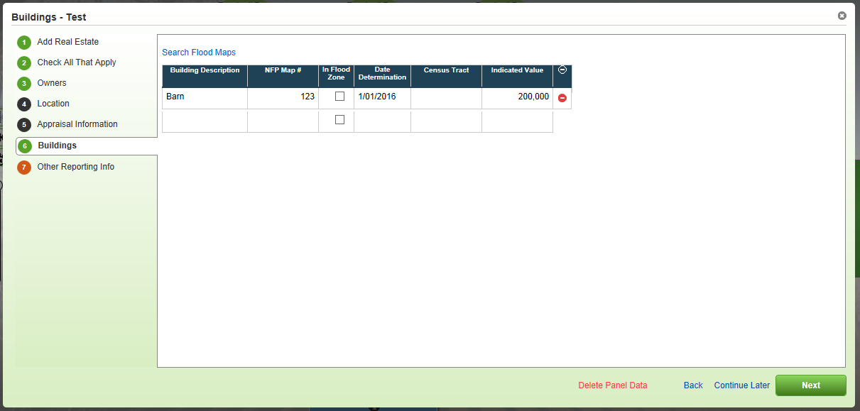
FEMA Hyperlink for Flood Maps

Slide 6
2017 IRS Requirements for Real Estate Collateral
For Tax Year 2016, IRS is requiring the collection of certain pieces of data:
(Box 7) Address of Property Securing Mortgage
(Box 8) Property Address (If Different form Payers’s/Borrower’s Address)
(Box 9) Property Description (If No Address Available), e.g.
Jackson County, MO
AA-BBB-CC-DD-EE-F-GG-HHH

Slide 7
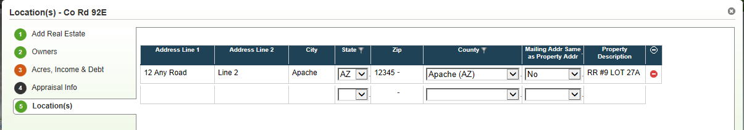
2017 IRS Requirements for Real Estate Collateral
Proposed Enhancement
Add fields to Locations panel for Real Estate:
“Mailing Addr Same as Property Addr”
Drop down for Yes/No
Will be required
Property Description
Will configure ON Address fields for all ACAs
If different mailing address, either address fields OR Property Description is required

Slide 8
Make Lien Position Configurable
Issue Reported
Request from FCE
Wanted to turn off Lien Position
Proposed Enhancement
Provide the ability to configure (at the association level) Lien Position ON or OFF
ON will be the default setting unless otherwise indicated
For those ACAs that wish to configure this OFF, will you ever need it for Participation loans?

Slide 9
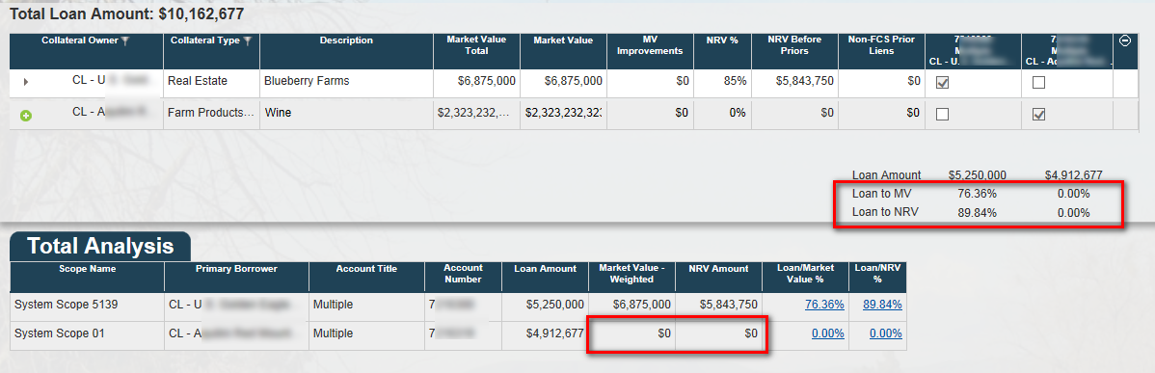
Purchased Participations Secured by Chattel
Issue Reported
Currently, if you have a participation loan secured by chattel, the MV and NRV of the chattel are not reflected in the Collateral Analysis screen:
Proposed Enhancement
The system should perform a behind-the-scenes check on LT loans.
If they are participation loans, rather than regular LT loans, then chattel will be allowed as a valid collateral type for securing the loan.

Slide 10
Edit Loan Position on Collateral Analysis
Issue Reported
Request from FCE
Ability to set Loan Position on the Collateral Analysis screen
Proposed Enhancement
When Lien Position is configured OFF, then Loan Position can be manually edited on the Collateral Analysis screen.
If Lien Position is configured ON, Loan Position will continue to be locked down on the Collateral Analysis screen.

Slide 11
Undefined Items
Provide a way to ensure that any newly calculated LTV ratios based on loan balance changes always get to LOS along with the recalculated LGD
Multiple Scenarios for same system scopes causing issues

Slide 12
Updated LTV/LGD to LOS
Issues Reported
NW: Refresh Button on Existing Loans
Add a refresh button on existing loans in Collateral Web to allow the program to recalculate the LTV ratio and LGD.
Currently, users have to trick the system to trigger a recalc. Users need to change something in a scenario, close and reopen the scenario, then revert whatever was changed to its original state.
AgC: Updated L/V and LGD not flowing to EmPOWER
Updated L/V and LGD do not flow to EmPOWER if the loan amount or other fields that affect collateral values do not change in CW.
Data must be “dirtied” in CW by modifying collateral amounts, etc. to trick the system into updating values so they can be resubmitted to EmPOWER.
Encounter the issue both on actions that require CW (loan origination) and actions that have no collateral impact (reamortization). In both cases, need accurate L/V and LGD.

Slide 13
Updated LTV/LGD to LOS
Stated business need:
Data integrity, internal and external audit issue.
PWC did a deep dive into LGD’s a few years ago, and multiple processes were put in place to monitor LGD’s for accuracy.
Forcing a user to put in “fake values” to trigger an update creates a significant data integrity issue.

Slide 14
What are we trying to solve?
Does LTV/LGD need to update for all loans in the scope when making a minor update (e.g. text change) in Collateral?
Does LTV/LGD need to update for all loans for the customer when working on one loan?
Do we need a way to force LTV/LGD to update in LOS because of amortization?
What is audit committee expecting to see that they are not?
Anything else?

Slide 15
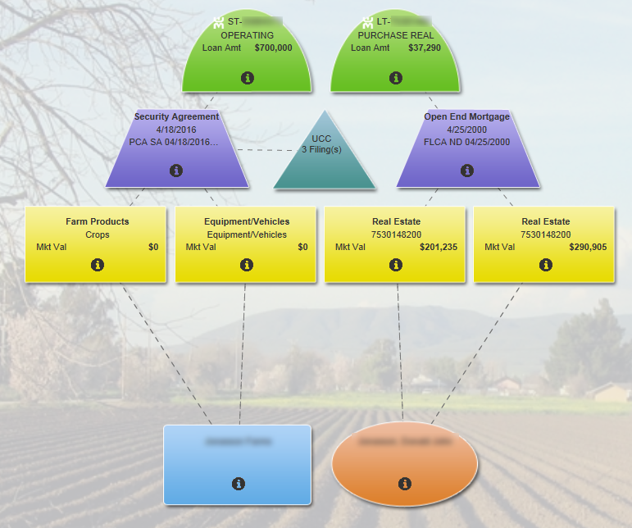
Example – 2 scopes, 2 loans
What do we expect here?

Slide 16
Multiple Scenarios for Same System Scopes
Issues Reported
AgC: Objects “owned” by a scenario not visible to other scenarios
Some situations require multiple scenarios for the same customer (branch is working PCA loans while Lending Operations is working on FLCA loans; loans may be booked at different times and be at different stages).
User is unable to see which objects are “owned” by which scenario; if they inadvertently make a change in an object “owned” by another scenario, CW locks up, FPI has to script out the scenario and we start over.
FCE: Goal is to reduce the number of multiple collateral scenarios.
It is probably infrequent that staff would want to create multiple scenarios for the same group of loans. Would like a warning if possible.
Notes:
See prior slide for scope/scenario discussion

Slide 17
Scenarios/system scopes
Possible solutions
Option 1:
Don’t allow multiple scenarios to be created per scope, but also don’t lock at the scenario level. Instead, lock at the system scope level so multiple users can work on the same customer at same time, just not on the same system scope.

Slide 18
Scenarios/system scopes
Option 2:
Start a new scenario, the app will ask you which scope/loans you want to include in the scenario.
If a scenario already exists for a particular scope, app will tell you.
Identified scopes in the scenario are pinned, all other scopes are grayed out.
Would have to start a new scenario to work on the other scope(s) – which could include a scenario to work across all scopes.
If multiple scenarios exist for a particular scope, when you go to submit any one of them to EmPOWER, app will warn you that all other scenarios for this scope will be deleted.
If you decide to continue and submit your scope to EmPOWER, then all other scenarios for that scope, or that include that scope (so the “all in” scenario), are deleted.

Slide 19
New Requests
Cross-collateralization flag in EmPOWER
One loan secured by collateral that is not shared or crossed with any other loan is appearing as crossed.
Editing Partial Release Data
Cannot currently edit partial release data before the scenario is submitted.

Slide 20
Proposed Schedule
10/5 – Code Complete
10/20 – QA (A, B, G, P and Q)
10/27 – QA (A, B, G, P and Q)
11/3 – QA (A, B, G, P and Q)
11/12 – Prod Release

Slide 21

Questions

